Slide 1



H1N1 VIRUS
VACCINE
Example
In a vaccination context, factors related to personal beliefs, attitudes, and knowledge about vaccines might be more critical

Slide 2


Problem Statement
Predict how likely it is that people will take the H1N1 flu vaccine using Logistic Regression

Slide 3



=> Which type of error is dangerous?
ERROR
Type I (FP)
Type I I (FN)
PRECISION
RECALL
0
TN
---------------
TN + FN
TN
---------------
TN + FP
SPECIFICITY
1
TP
---------------
TP + FP
TP
---------------
TP + FN
SENSITIVITY
=> Precision of 0 & sensitivity should be high

Slide 4


High Bias
Logistic Regression
Parametric Algorithm
Low Variance

Slide 5
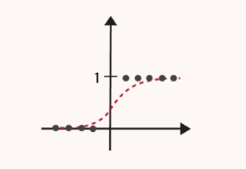
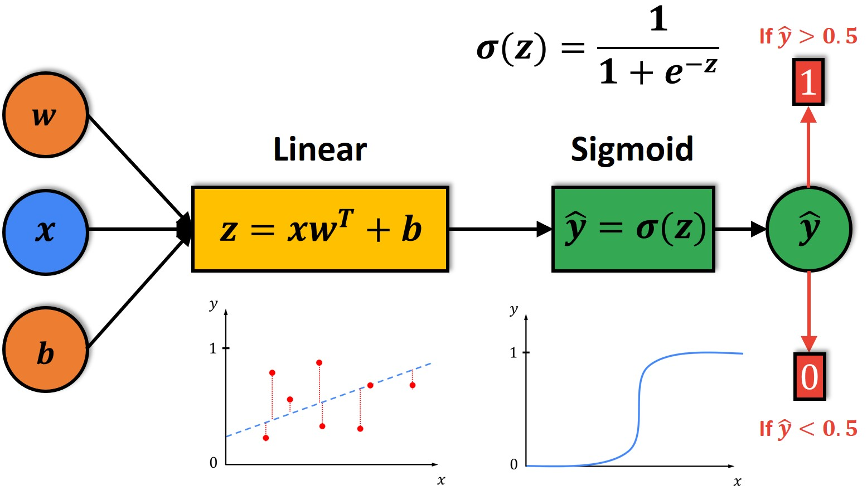
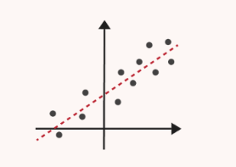

Slide 6



Dataset Summary
Health and Vaccination
Demographic Information
- `unique_id` - `age_bracket` - `qualification` - `race` - `sex` - `income_level` - `marital_status` - `housing_status` - `employment` - `census_msa`
- `h1n1_worry`
- `h1n1_awareness`
- `antiviral_medication`
- `contact_avoidance`
- `bought_face_mask`
- `wash_hands_frequently`
- `...` (similar variables for seasonal flu)
Household Information
- `no_of_adults’
- `no_of_children’
TV – H1N1 Vaccine

Slide 7
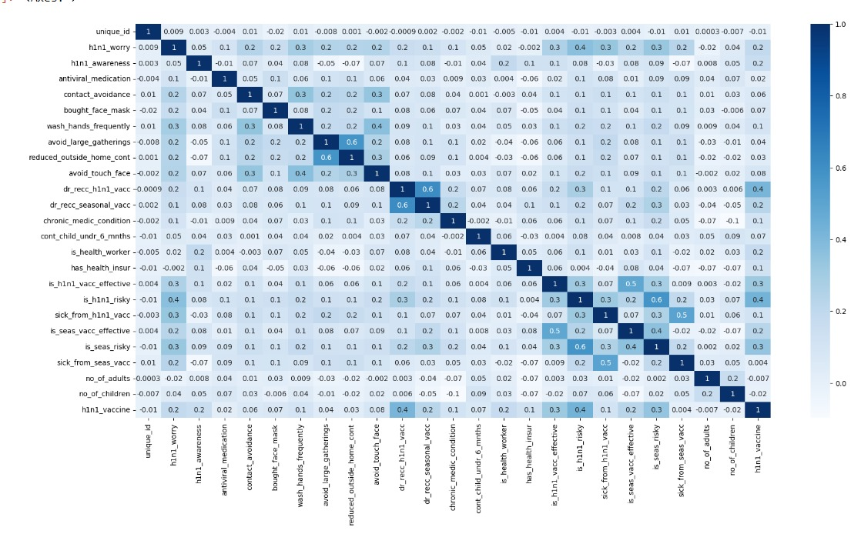
Heat Map

Slide 8









Building a risk-averse model
=> What is risk-averse model?
Outliers/ Irrelevant data/ Redundant Data
Feature Engineering
Building Model
EDA
Feature Transformation
Evaluate Model
Evaluate Model & Compare
=> What are the issues with the model?

Slide 9
Assumptions of LR
=> Linear
=> No edogenity
=> No autocorrelation
=> No multicollinearity
Hausman Test
Dubrin Watson Test
VIF
=> All independent must be dichotomous or numerical variables

Slide 10
Feature Selection
=> Recursive Feature Elimination
=> SelectKBest method
=> Can we manipulate the data?

Slide 11
Observation
S.No | Model | Precision (0) | Sensitivity | Accuracy | Precision (1) | Specificity
1. | Logistic Regression | 86|86 | 41|44 | 83|84 | 68|69 | 95|95
2 | Logisitic Regression with class_weight | 89|89 | 64|65 | 74|74 | 42|43 | 76|76
3 | After manipulating the data | 85|86 | 40|41 | 83|83 | 68|67 | 95|95
4 | Recursive Feature Elimination | 84|84 | 32|33 | 82|82 | 66|64 | 95|95
5 | SelectKBest Method | 84|84 | 34|34 | 82|82 | 63|63 | 95|94
6 | SMOTE | 75|89 | 73|65 | 76|76 | 77|45 | 79|79
7 | ADASYN | 74|89 | 73|65 | 75|74 | 76|43 | 76|76
8 | Feature Selection with SMOTE | 71|91 | 85|87 | 61|47 | 57|27 | 36|36
9 | Feature Selection with ADASYN | 69|92 | 85|89 | 60|46 | 57|27 | 34|34
10 | Hyper parameters (GridSearchCV()) | 85|86 | 40|41 | 83|83 | 68|67 | 95|95
11 | Hyper parameters (GridSearchCV()) with SMOTE | 75|90 | 75|67 | 76|75 | 77|44 | 77|77

Slide 12

Suggestions
=> Features
=> Knowledge Domain

